Slide 1
ARUS 280 HW #6
Eagle Eisenstein as a Semiotician
Taylor’s article “Cinema” from the Blackwell Encyclopedia of the Russian Revolution
The Strike (Sergei Eisenstein, 1924, 1:35)
Beumers’s Cinema the chapter by Richard Taylor, “THE STRIKE” (47–56).

Slide 2
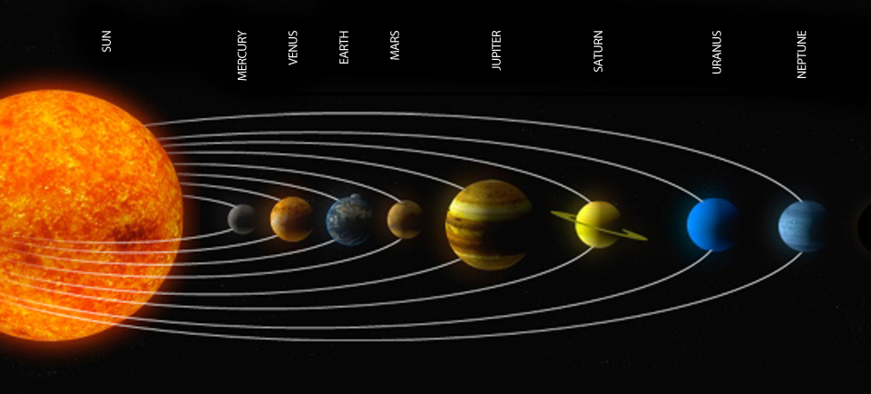
Project Overview
Type a brief overview or summary of your project here.

Slide 3
Research
Summarize your research here in three to five bullet points:
1st bullet point
2nd bullet point
3rd bullet point
4th bullet point
5th bullet point
DA DA DEE DO BOP
DAH DA DA DAH
DA DA DEE DOO BOP DO DOO DOO TADA

Slide 4
Works Cited
Be sure to include print and electronic sources and put them in alphabetical order.

